Slide 1
PC613: Communication Skills
Sem I, MSc IT
Instructor: Dr. Jenson Joseph

Slide 2
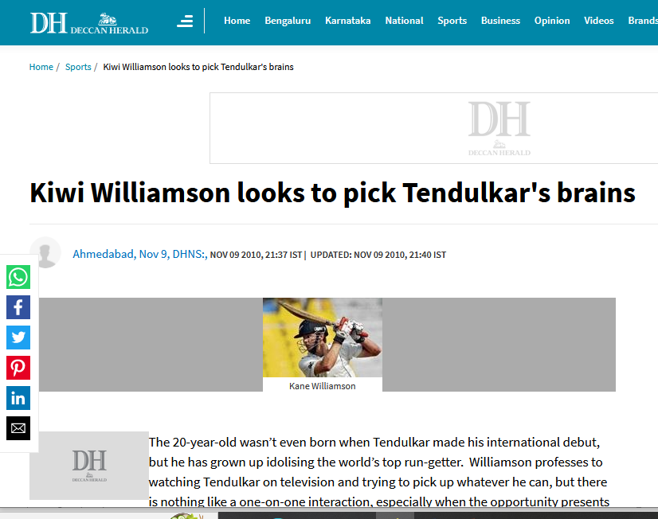
Learn an idiom
“To pick someone’s brains”

Slide 3
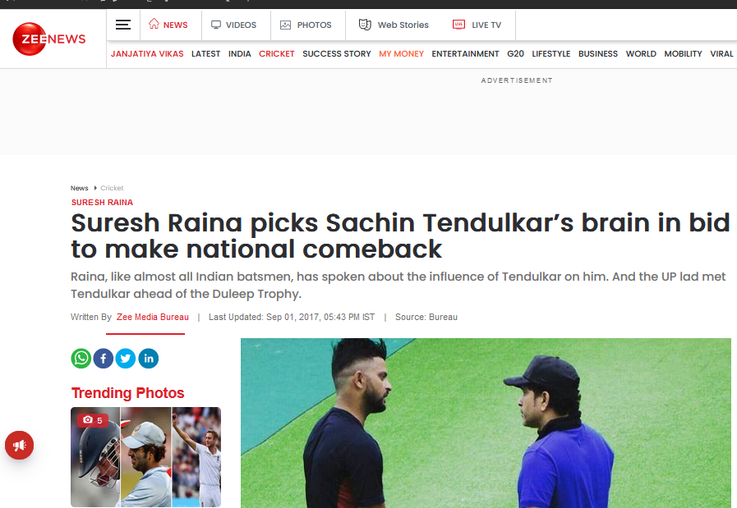
Learn an idiom
“To pick someone’s brains”

Slide 4
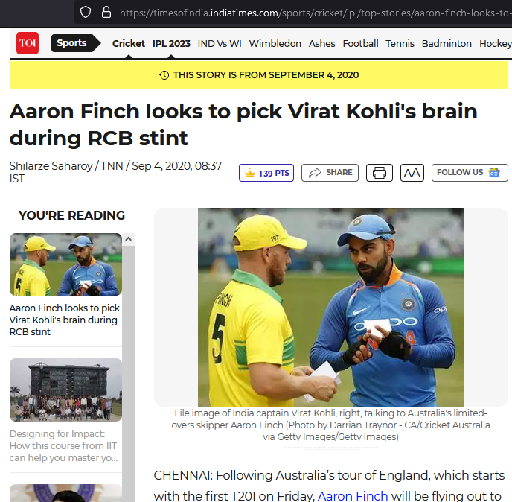
Learn an idiom
“To pick someone’s brains”

Slide 5
Learn an idiom
“To pick someone’s brains”
to talk to someone in order to get helpful information or advice.
to ask someone who knows a lot about a subject for information or their opinion:
Note: Used in informal contexts.
Examples:
Do you have a moment? I need to pick your brain about a little situation that has come up.
I was picking my friend's brains about which computer to buy.
“Can I buy you coffee and pick your brain?” (Remember: Only in informal contexts, with friends).

Slide 6
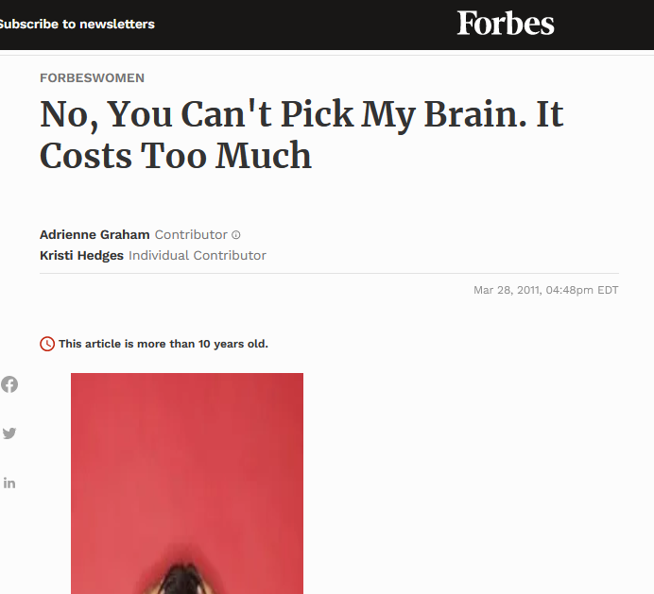
Learn an idiom
“To pick someone’s brain”
Alternative:
“I would like your advice.”
‘Hey, would you be open to either a phone call or an email dialogue?’
People respond more positively to these phrasings because it conveys intention; that you’re approaching a certain person for very particular reasons.

Slide 7
Class presentations: Groups of five
Construct a scenario
Groups will be assigned a themes;
Each group has to construct a scenario around the theme;
The scenario should include 5 characters and their conversations;
Every character should have at least 4 lines to speak;
Each group will either stage the scenario in the class in front of every one, or
Make a video in the Instagram reel format and play the video in class.
Scenarios should be 5 minutes long (min), and not longer than 8 mins.

Slide 8
Lesson 1: Introducing Oneself
Follow the format given below, but feel free to improvise
Begin with:
Hi everyone
Hello friends
Good morning, everyone/Good morning, all/Good morning, guys
Proceed to: “I am ….; I come from…; my hobbies are…/ I like..; This is the first time I…”
End with pleasantries, like:
I look forward to knowing you all better
Wish you all a great time on campus
Hope you all enjoy your time in DA-IICT

Slide 9
https://www.youtube.com/watch?v=WYDfjV2B5Gk
https://www.youtube.com/watch?v=G2wkO0DhpEY
https://www.songlyrics.com/ella-fitzgerald-louis-armstrong/you-say-tomato-i-say-tomato-lyrics/

